Slide 1

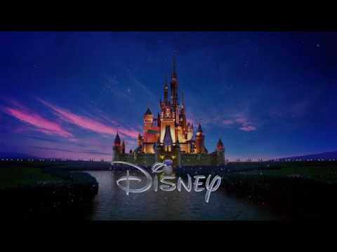

Slide 2



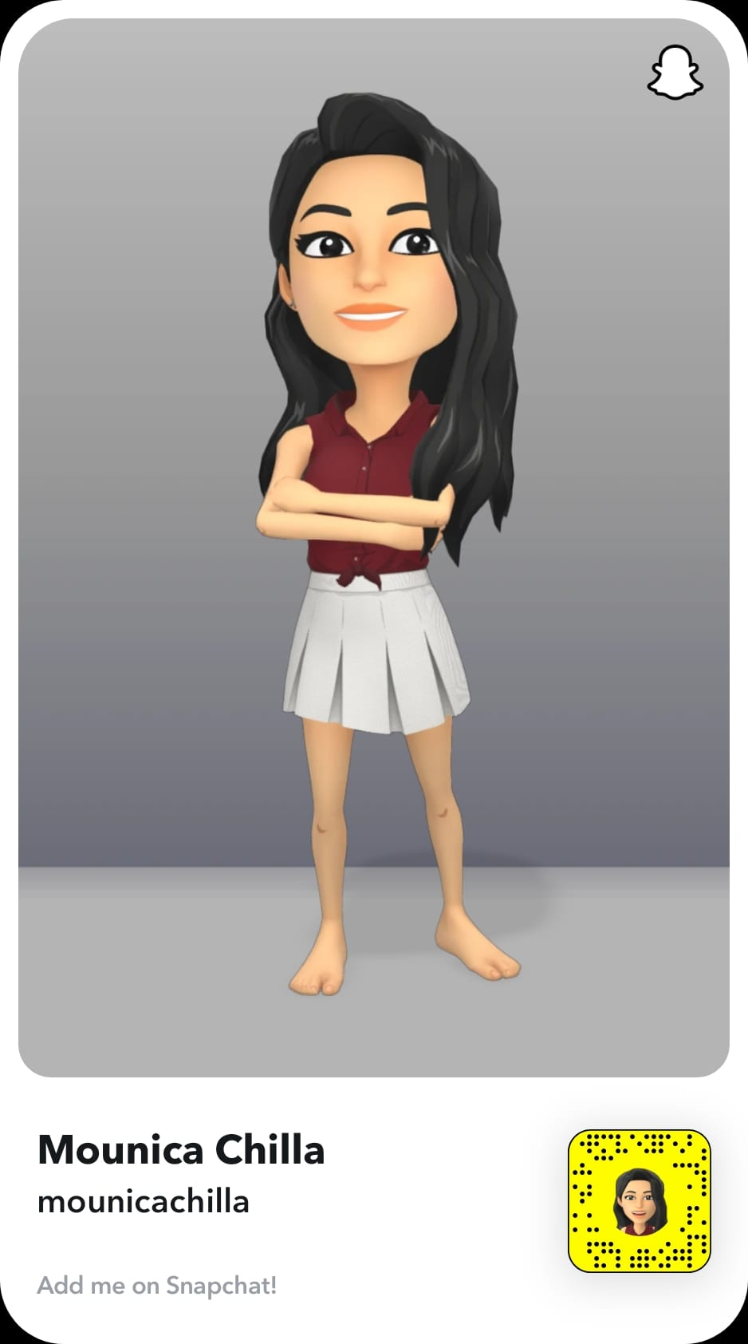

PRAYING MANTISES
Anjali Gaurav
Keerthana Vankayalapati
Madhumita Sekar
Mounica Chilla
Shreshta
Mahankali

Slide 3
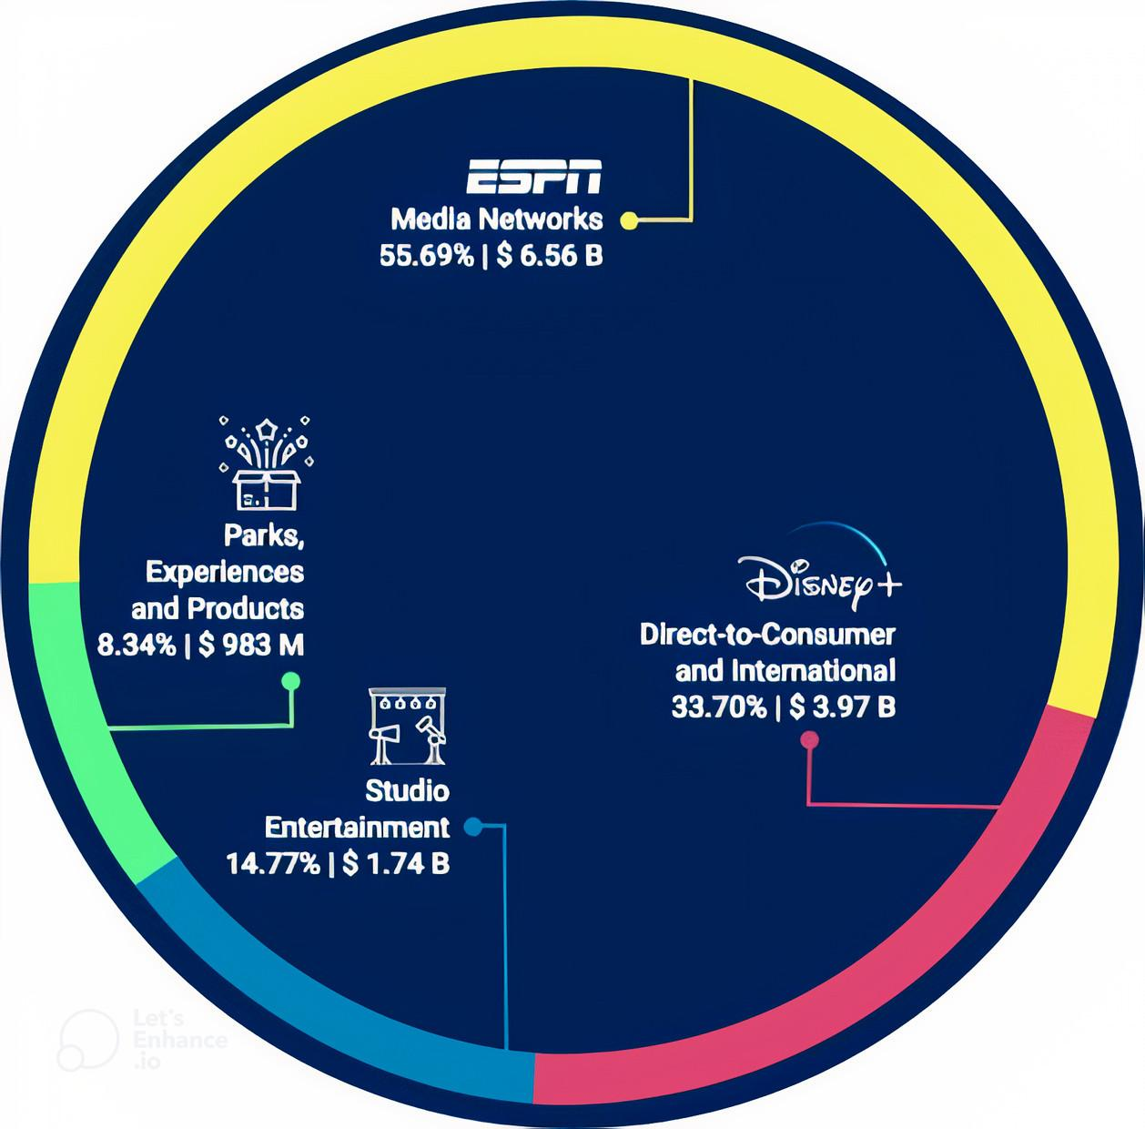





OVERVIEW
Leader in the Entertainment Industry
Pioneer of Animated Films
1923
Walt & Roy O. Disney
2018 Strategic Reorganization
55 Billion U.S. dollars in 2022
Diversity & Innovation

Slide 4
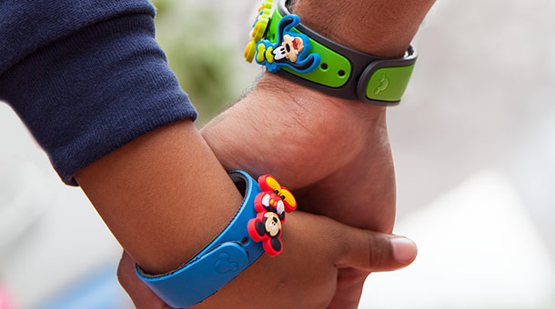


MagicBands – wearable technology
Radio-frequency identification (RFID) technology
INNOVATIONS
Brand new chandelier
Hybrid water coaster
Use of Wave Phones
OTT streaming
Movies and shows from Disney, Pixar, Marvel, Lucasfilm and National Geographic.
Notes:
Popular innovations - Theme parks , Disney plus, Cruise

Slide 5


DISNEY PLUS
Over the top (OTT) streaming service
By Media & Entertainment Division
Launched in Nov 2019
WHAT
Generated $5.2B revenue in 2021, an 85% increase YOY
Reached over 100M subs in March 2021
App downloaded over 200M times since launch
STATS
Ending of the streaming deal with Netflix
Leverage data gathered from other divisions
Decline of cable channel business
WHY
Cheaper than the competitors
Franchised Content Library
Multi Device Supported (upto 10)
FEATURES
Tech Problems & Architecture Limitations
Poor Customer Service
Slow at Producing New Content
PROBLEMS

Slide 6

01
Sustaining Innovation
02
Era of Incremental Change
No New Market creation
Attractive opportunity
High Performance
Streaming Wars - Netflix/Prime
Market growth
Focus of Performance Improvement
FRAMEWORKS
03
Competence-enhancing
04
Creativity
N
Entered at Growth stage
Strong Commitment
High Org Separation
Dreamer - Realist - Critic
Sutton’s philosophy
Ambidextrous organization
Sutton’ s philosophy
Creative lab - Management sparks creativity
Dreamer - Realist - Critic
Notes:
Network effects

Slide 7

FEEDBACK
01
Case linkage to Frameworks
02
Future of Streaming Wars
THANK YOU !

